Slide 1
Click Sensor Hub
Picture of Board here vs Hexiwear
Presentation schedule:
I: Context
II: Overview
III: Hardware
IV: Software
V: Results
Teammates/Sponsors/Etc

Slide 2
What is a Click?
Create a PCB that connects a KL46Z and 4 MikroBUS Sockets

Slide 3
Why use Clicks?
Create a PCB that connects a KL46Z and 4 MikroBUS Sockets

Slide 4
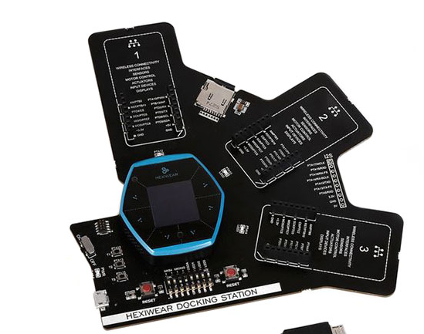
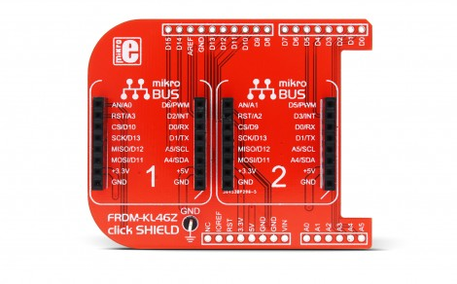
What devices use Clicks?
Hexiwear
Click Shield

Slide 5
Project Overview
Reasons
- IoT prototyping for Texas State Students in Dr Stapletons class
Click Library support on forums for IoT prototyping of Hexiwear board
Elevator Pitch?
Project Motivation
Reasons
- IoT prototyping for Texas State Students in Dr Stapletons class
Click Library support on forums for IoT prototyping of Hexiwear board
- Both the FRDM and the Hexiwear are NXP products

Slide 6
How did we design hardware?
Schematic
What we used (Eagle CAD)
3D Model Picture

Slide 7
Hardware – First Board Design
Picture of Board here
Pros/Cons

Slide 8
Hardware – Second Board Design
Picture of Board here
Pros/Cons

Slide 9
Hardware – Third Board Design
Picture of Board here
Pros/Cons

Slide 10
How did we write the software?
Figure 4 – what the KL46Z sees
We used the Mbed Compiler (arm based compiler)
Each of the Clicks worked on individually

Slide 11
Example of I2C Click Code
PuTTY output
Lightranger Picture
Diagram of Pull up network

Slide 12
Example of SPI Click Code
Bargraph Schematic
Video

Slide 13
Results of Click Testing
Table

Slide 14
Results of Board Testing
Table

Slide 15
Acknowledgements
Dr both

